Slide 1


Team 26: Voice-Controlled Robot
Bi-Weekly Update 2 Logan Cardwell, Dawson Holly,
Nicholas McCray, Cameron Schoenfeld Sponsor: Zhewen Hu TA: Zhewen Hu
Notes:
Michelle

Slide 2
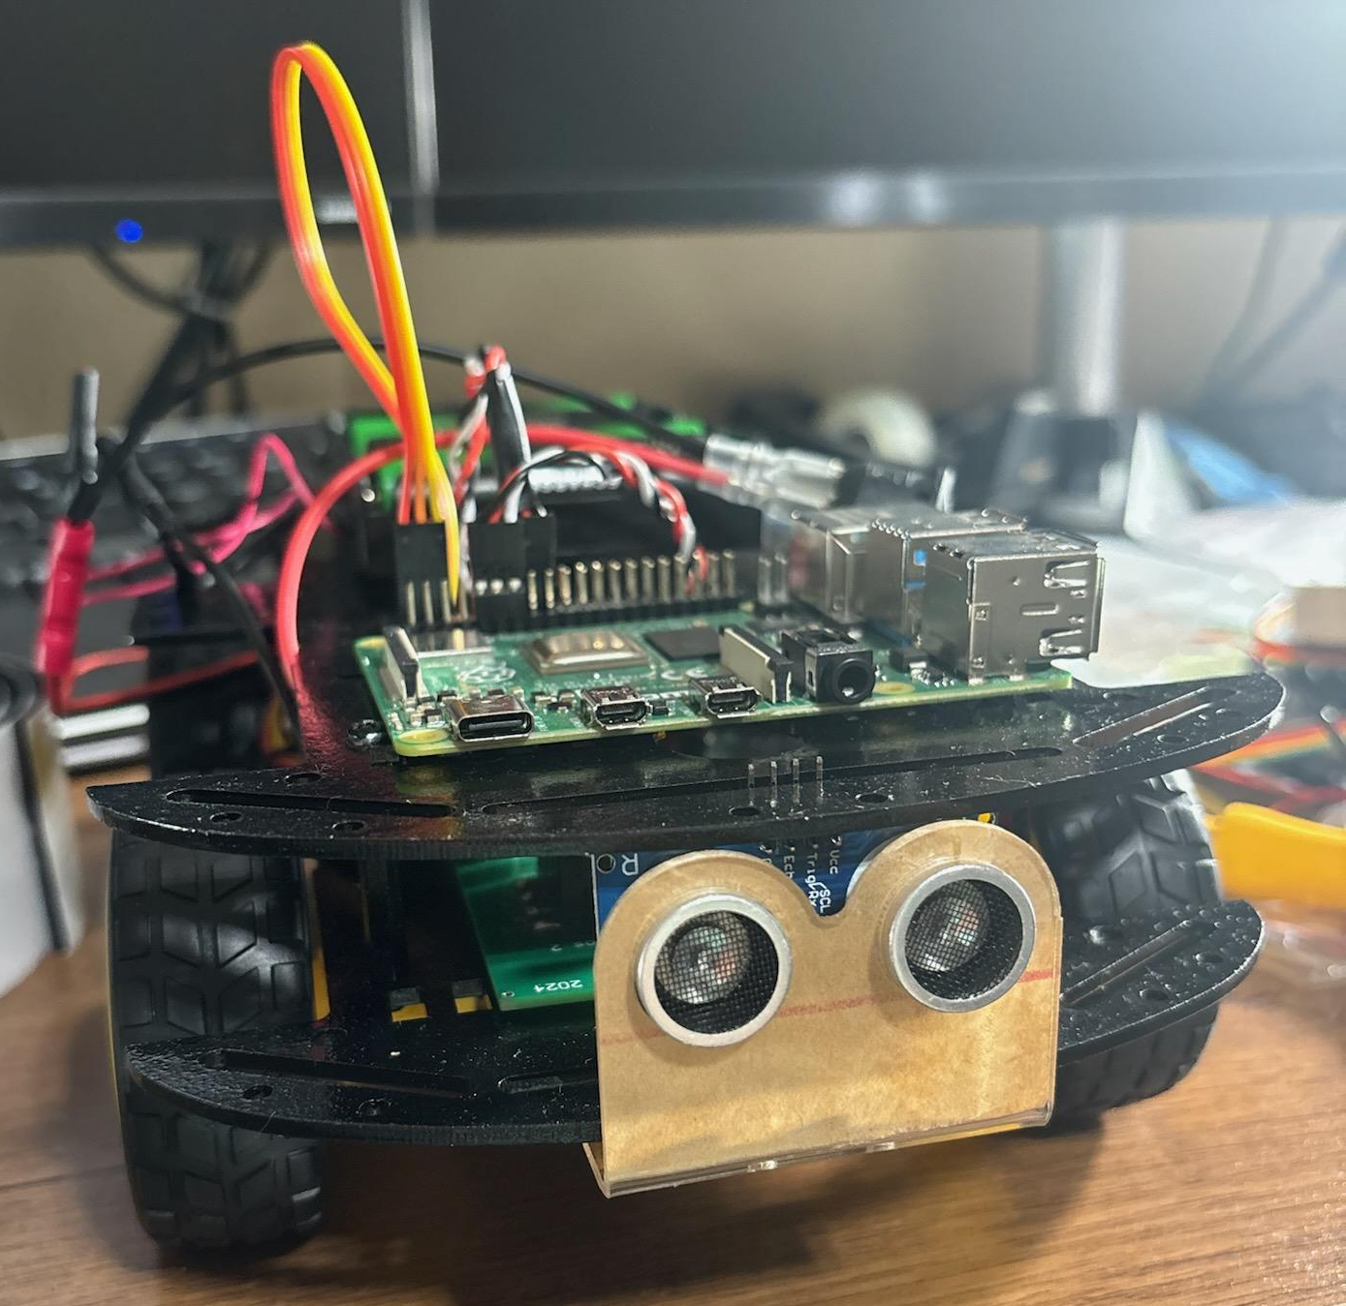
Project Summary
We are creating a simple robot that can be modified and adapted for use in various situations, primarily as robotic food runners in restaurants and similar environments.
The robot is able to take in voice commands and manual control from a mobile application to direct its movement while sensors detect and prevent imminent collisions. Additionally, the robot will be able to record and follow paths between points for ease of navigation.
Notes:
Kyle

Slide 3
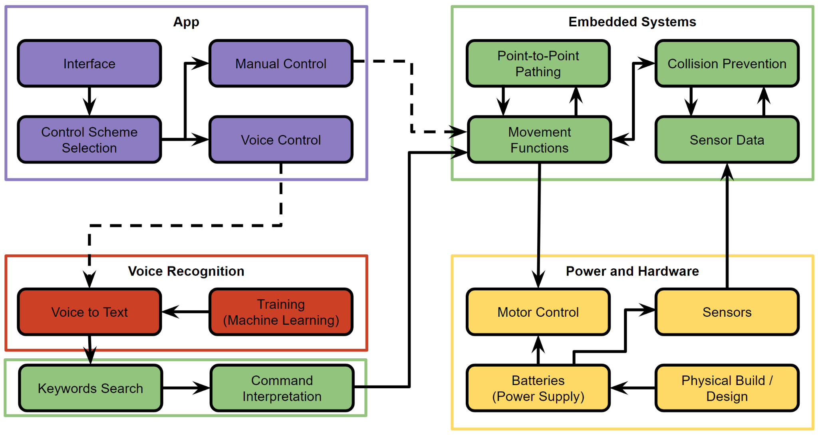
Project/Subsystem Overview
Voice Recognition: Outputs text transcription from received audio file.
Power and Hardware: Provides the required power for the motor driver and the raspberry pi.
App Design:
Receive manual and audio commands to transmit to the robot.
Embedded Systems:
Underlying logic and data flow between all other subsystems.
Logan Cardwell Dawson Holly Nicholas McCray Cameron Schoenfeld
Notes:
Dawson

Slide 4
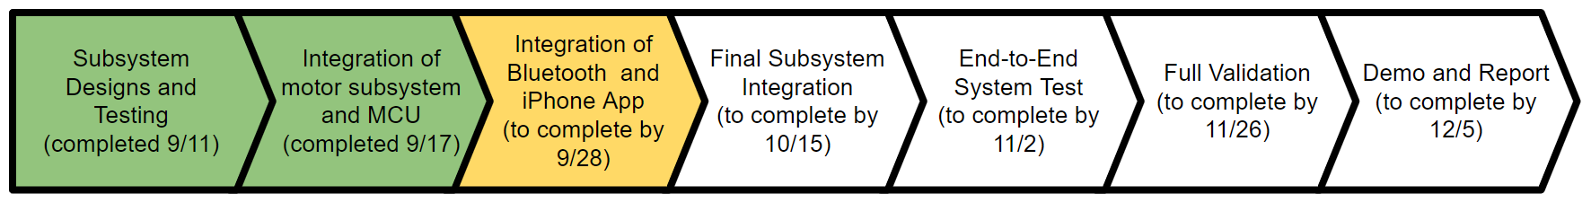
Project Timeline
Notes:
Eric

Slide 5
Voice Recognition
Logan Cardwell
Accomplishments since last update 20 hrs of effort | Ongoing progress/problems and plans until the next presentation
~29,000 lines of dialogue from the LibriSpeech database were added to the STT system dataset to give the model context. An additional 600 command audio files have been added to the dataset and transcribed. A new functional model has been trained. | The final STT version is currently being trained in the background. It is being trained for 300 epochs (cycles), which will take several days. I am going to assist Dawson and Cameron with the integration process moving forward

Slide 6
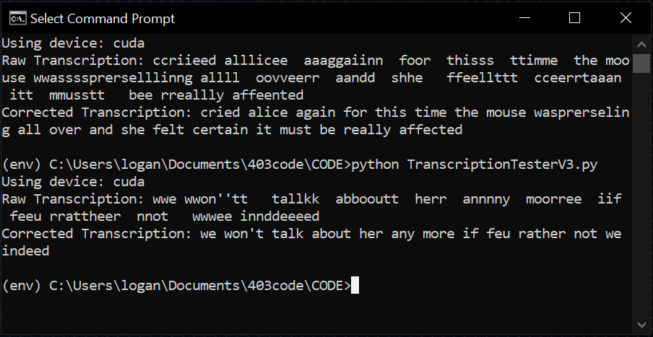
Voice Recognition
Logan Cardwell
The model now has enough context to understand when invalid inputs are made, and enough accuracy to properly transcribe commands.
Accuracy of general (non-command) transcription is not yet up to validation standard on the current 50 epoch model, so the model is being trained over more epochs to bring its complete success rate above 80%. The training process will be finished in about 4 days.

Slide 7
Power & Hardware
Dawson Holly
Accomplishments since last update 17 hrs of effort | Ongoing progress/problems and plans until the next presentation
A robot subframe has been completed with all components securely mounted. A fan has been added to help regulate Motor Driver temperatures. The total current provided to the robot has been increased to help prevent load draws and stalling. Successful E-Load testing has been completed. Tidied any loose and unnecessary wiring. | Begin design on the outer shell of the robot. Determine the maximum payload capacity of the design. Review the possibility of using a different type of battery to power the robot. Monitor the temperature of Raspberry Pi, and ensure that an additional fan is not needed. Begin testing of robot from the mobile app. Continue to upgrade the subframe to increase the ability to carry extra weight, and protect from unavoidable crashes.

Slide 8
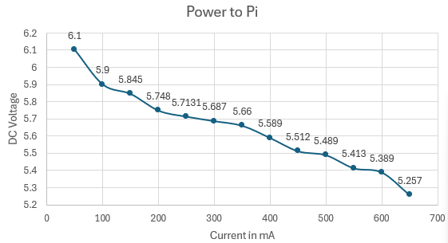
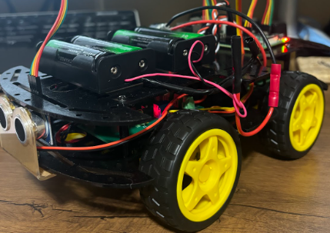
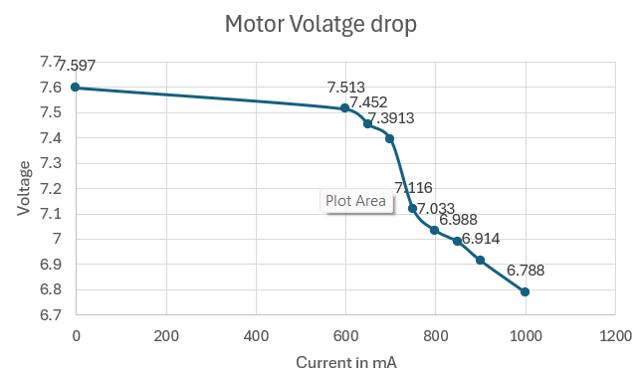
Power & Hardware
Dawson Holly
Placed two 7.5 Volt batteries in
parallel to reduce the voltage drop.
Began working on the physical body of
Robot.
All components are wired, tested, and
functional.
Will began the additional sub-frame
design, and further testing.

Slide 9
App Design
Nicholas McCray
Accomplishments since last update 11 hrs of effort | Ongoing progress/problems and plans until the next presentation
Updated outdated BLE code not asking for permissions Tested BLE connection to Raspberry Pi 4 | By next review will implement and test signal sending via BLE Begin integration of file I/O

Slide 10
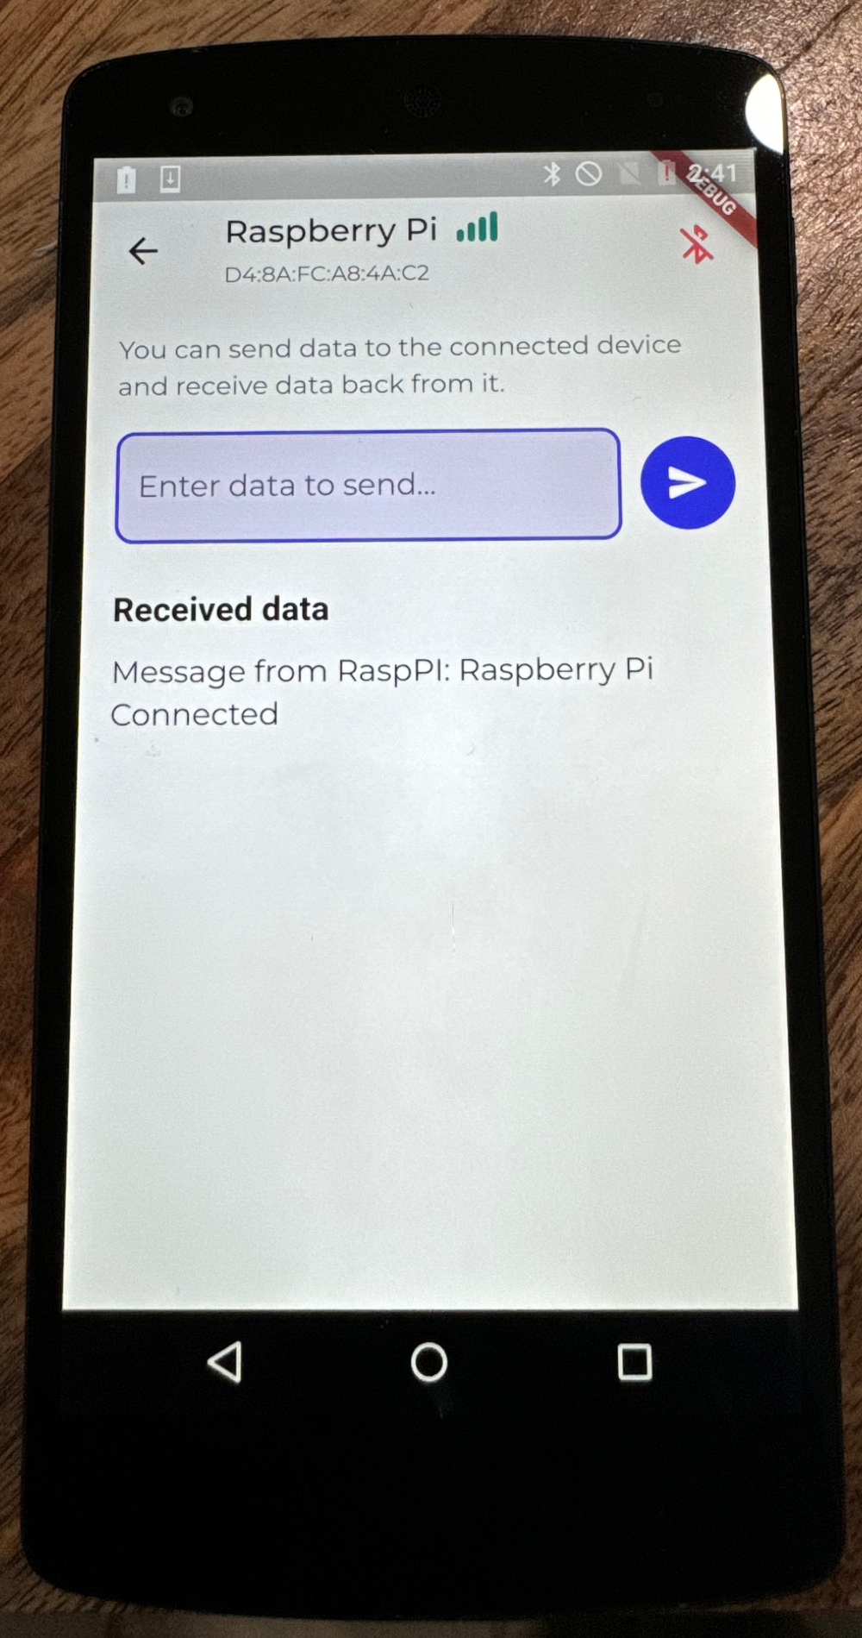
App Design
Nicholas McCray
Image of Bluetooth signal sending page, linked to Raspberry Pi terminal.
BLE connected to Raspberry Pi, strong RSSI, sends and receives text from terminal.

Slide 11
Embedded Systems
Cameron Schoenfeld
Accomplishments since last update 12 hrs of effort | Ongoing progress/problems and plans until the next presentation
Added ‘virtual marker’ placement functionality Tested integrated motors to ensure proper control signals | By next review, ‘marker-to-marker’ pathfinding algorithm will be developed Integration with Voice Recognition software Establish Bluetooth connection between the robot and the app

Slide 12
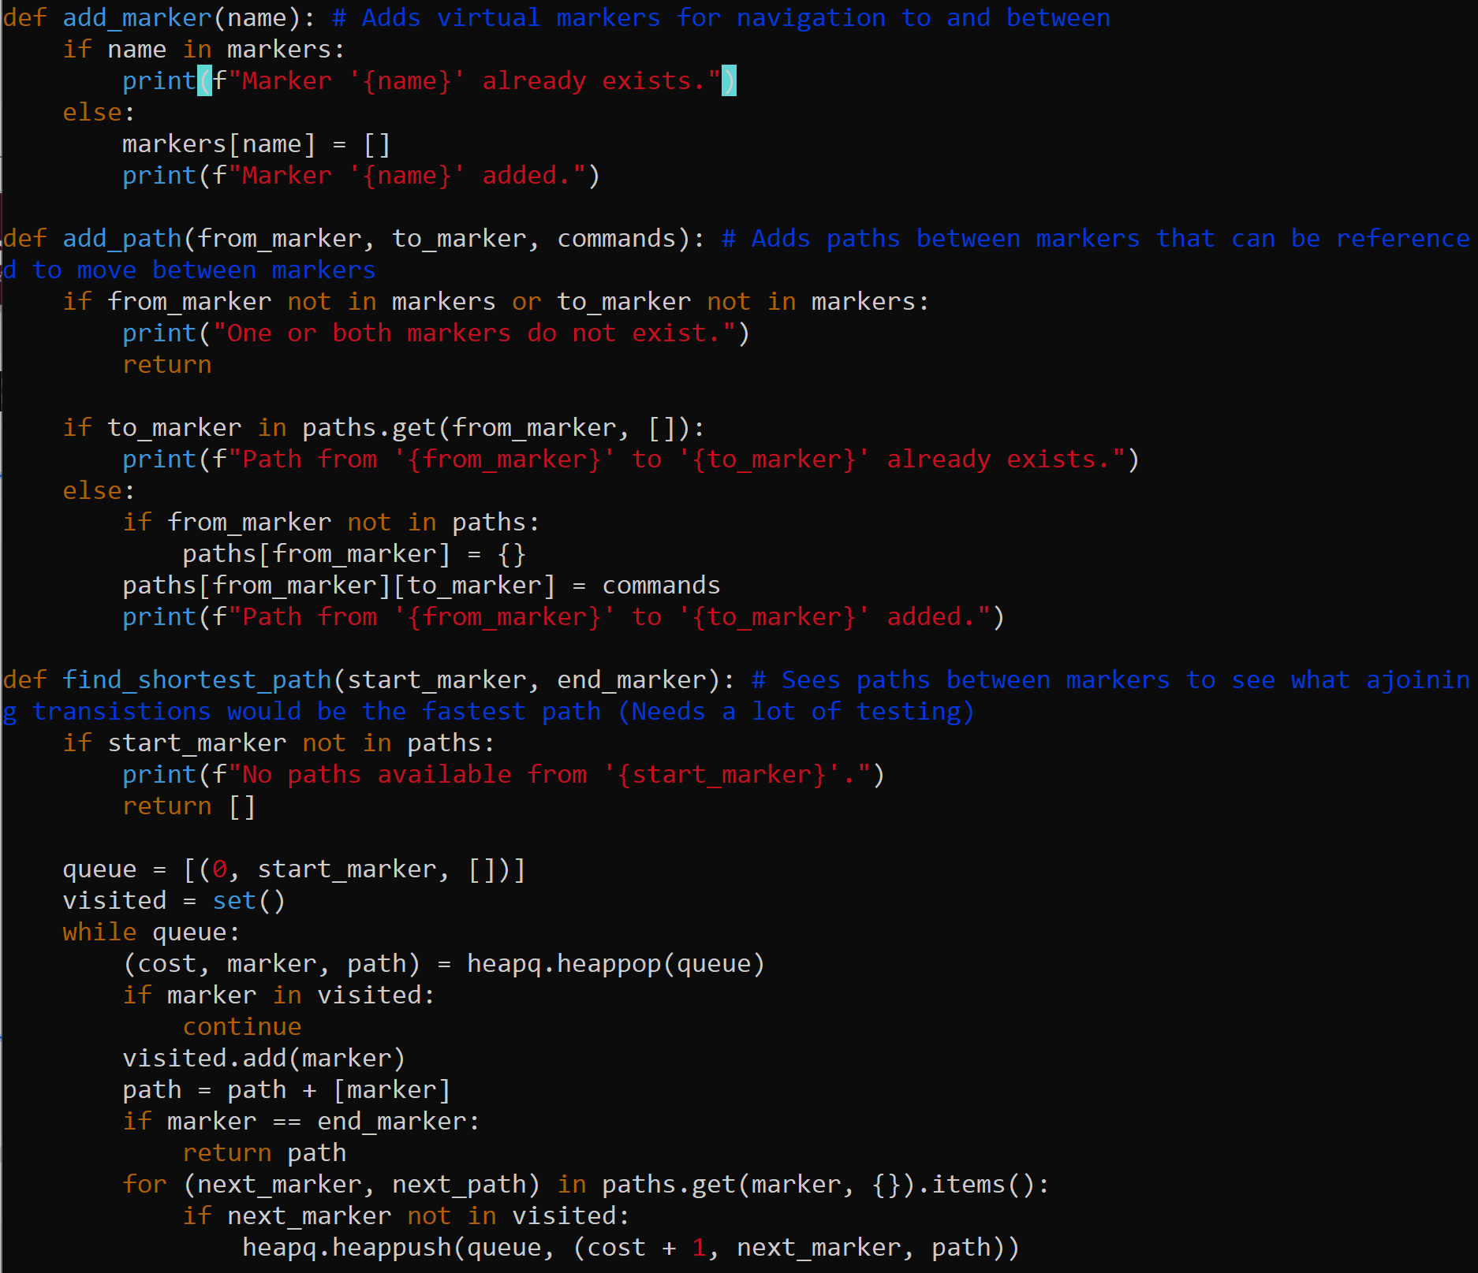
Embedded Systems
Cameron Schoenfeld
Snippet of added functions for the virtual markers and pathing system.
Additional modifications to already built functions to add marker and path creation.

Slide 13
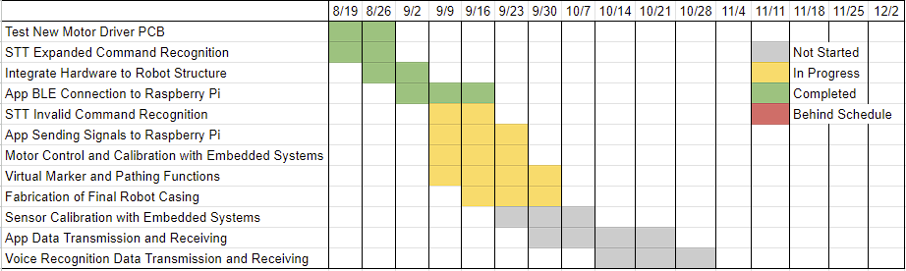
Execution Plan
Notes:
Michelle

Slide 14
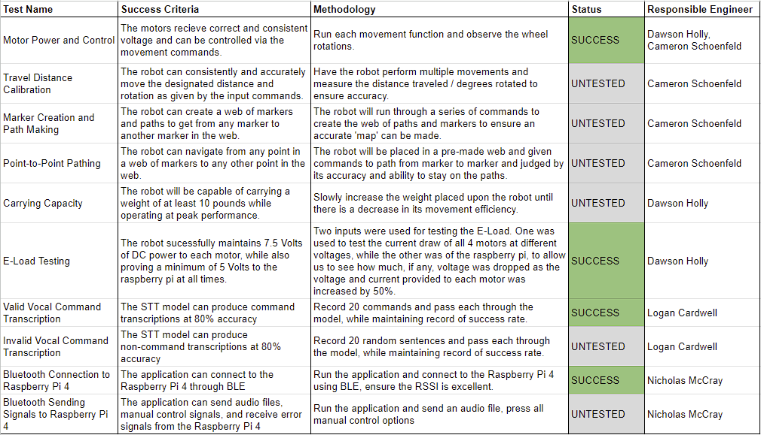
Validation Plan
Notes:
Michelle

Slide 15
Thank You!

